Slide 1

CSC- 362 Computer Networks Week-8 Lecture-15-16
Prepared by:
Mr. Attique Ur Rehman

Slide 2
Instructor Contact Details
Name: Mr. Attique Ur Rehman
Course Instructor: CSC362- Computer Networks
Credit Hours: (3+1)=4
Office Location: 2nd Floor Computer Science Faculty Office: 41-C
Email: attique.rehman@lgu.edu.pk
Visiting Hours: Wednesday (11:30 am -1:00 pm)

Slide 3
Course Material
Reference books
Many textbooks on Networking may be consulted
Research papers!
RFCs and Internet drafts
Related to TCP/IP suite and other protocols
Web resources
Tutorials, white papers, reports, etc.

Slide 4
Text Book
Computer Networks: A Systems Approach by Larry L. Peterson and Bruce S. Davies.
Third Edition [2003], Morgan Kaufmann Publishers, San Mateo, California, USA
Computer Networks by Andrew S. Tanenbaum
Fifth Edition
Data Communication and Computer Networks, by Behrouz A. Forouzan
5th Edition
Data and Computer Communications by William Stallings
10th Edition
Computer Networking: A Top-Down Approach Featuring the Internet by James F. Kurose and Keith W. Ross
6th edition

Slide 5
The Big Picture
You are here

Slide 6
What we know …
Elements of networks: nodes and links
Building a packet abstraction on a link
Transmission, and units of communication data
Detecting transmission errors
Simulating an error-free, reliable channel
Sliding window mechanism
Arbitrating access to a shared medium
Design issues of direct link networks
Functionality of network adaptors

Slide 7
What Next …?
LANs do not normally operate in isolation. They are connected to one another or internet
To connect LANs or segments of LANs connecting devices are used.
Connecting devices operates in different layers of internet model.
This chapter discuss which operates at physical and data link layer

Slide 8
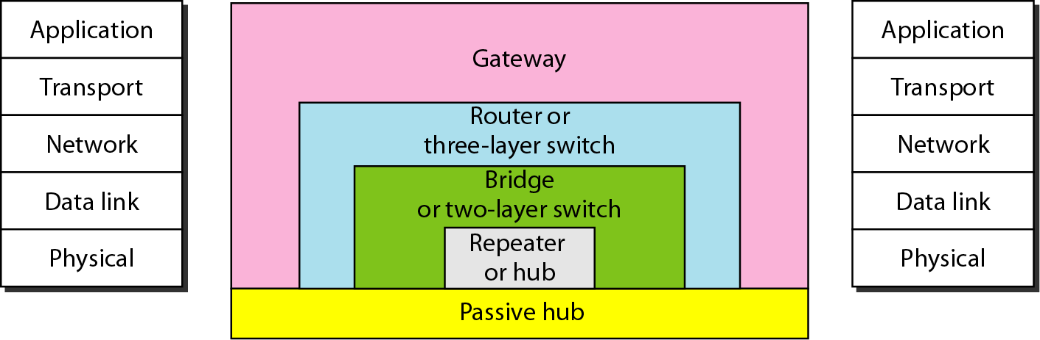
Connecting Devices
Passive hubs
Repeater/Active hubs
Bridges or two layer switches
Routers or three layer switches
Gateways

Slide 9
Passive hubs
A passive hub is just a connector
It connects the wires coming from different branches
In star topology Ethernet LAN
a passive hub is a point where the signal coming from different nodes collide.
The passive hub is a collision point.
Passive hub is a part of transmission media and operate below the physical layer

Slide 10
Repeater
A repeater is device which operates only in the physical layer
It receives a signal and before, it becomes too weak or corrupted, regenerate the original bit pattern.
The repeater sends the refreshed signal.
A repeater can extend the physical length of a LAN

Slide 11
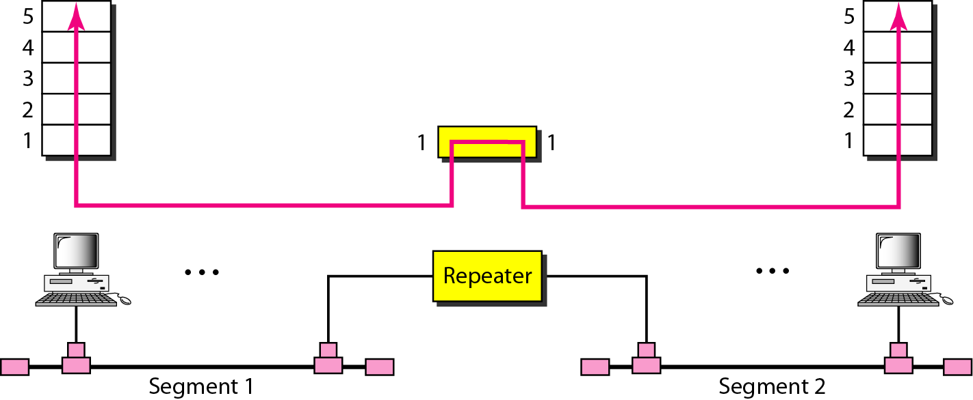
Repeater
A repeater connects segments of a LAN.
A repeater forwards every frame – there is no filtering.
A repeater is a regenerator, not an amplifier.

Slide 12
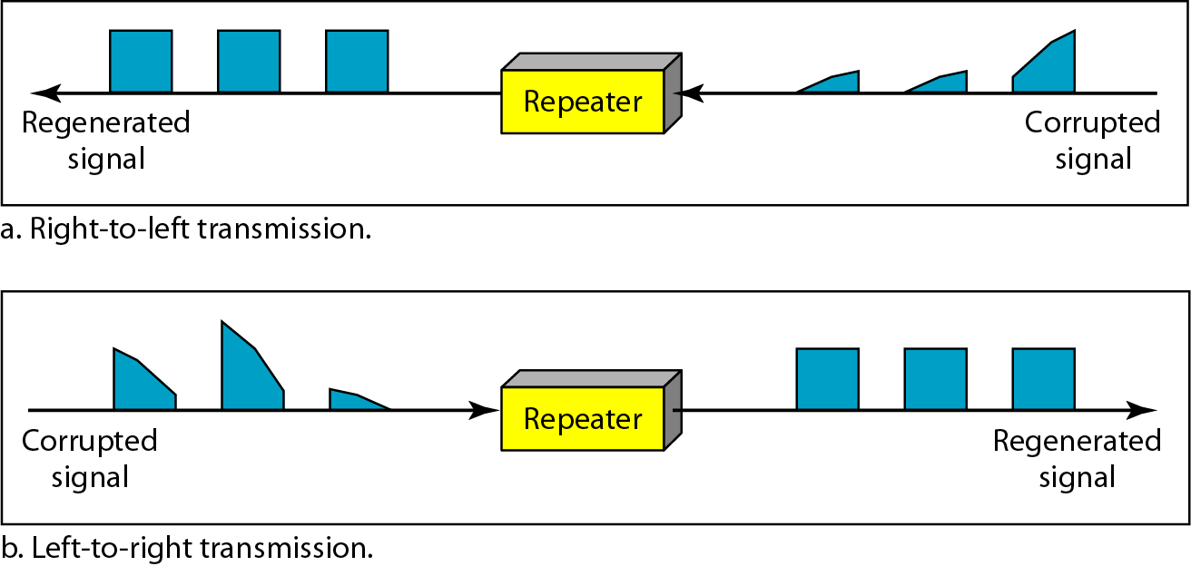
Function of Repeater

Slide 13
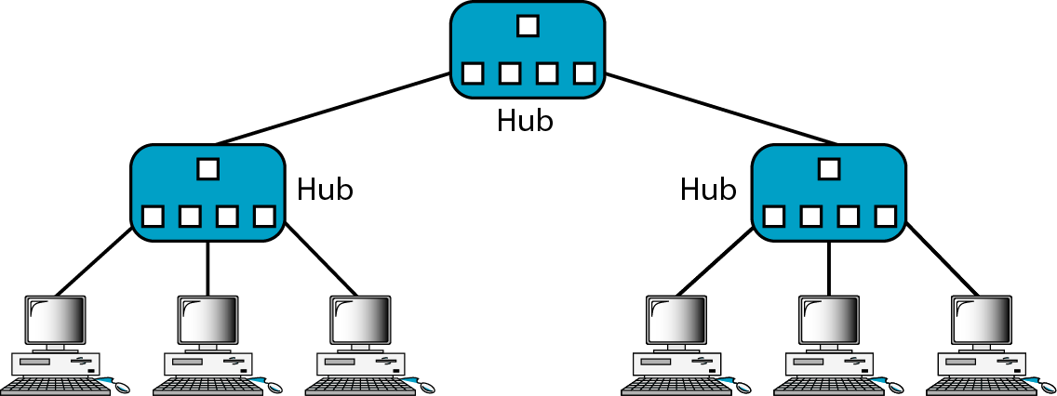
Active Hubs
An active hub is a multi-port repeater, used in star-wired LANs (Ethernet).
Operate at physical link
Because of the amount of traffic and collisions, hubs can only be used in small network configurations.

Slide 14
Building Extended LANs
Traditional LAN
Shared medium (e.g., Ethernet)
Cheap, easy to administer
Supports broadcast traffic
Problem
Scale LAN concept
Larger geographic area (> O(1 km))
More hosts (> O(100))
But retain LAN-like functionality
Solution: bridges

Slide 15
Bridges
Connect two or more LANs with a bridge
Operates in both physical and data link layer
as a physical device, it regenerates the signal it receive.
as a data link device, it check the MAC address of source and destination contained in the frame.
Transparently extends a LAN over multiple networks
Comprises 2 to 4 ports
accept and forward strategy (in promiscuous mode)
level 2 connection (does not add packet header)
A
B
C
Port 1
Bridge
Port 2
X
Y
Z

Slide 16
Switches
Switches like bridges are used to connect the subdivided segments of networks.
It is a Layer 2 devices. Operate at the Data Link Layer (Layer 2) of the OSI Reference Models.
Switches use the best of hubs and bridges while adding more abilities
Multi-port ability of hub
Filtering ability of a bridge

Slide 17
Switches
Switches can perform error checking before forwarding data.
which are very efficient by not forwarding packets that error-end out or forwarding good packets selectively to correct devices only.
Network Switches and Bridges have many similarities and similar function.
But Switches are considered as superior devices than bridges.

Slide 18
Bridges vs. Switches
Packet forwarding
Bridges are performed using software.
Switches are performed using hardware/ASICs (Application Specific Integrated Circuits).
Speed
Switches operate comparatively higher speeds as compared to bridges.
Method of switching
Bridge is store and forward.
Switch can be store and forward, cut-through or fragment-free.

Slide 19
Bridges vs. Switches
Number of Ports
Switch has more ports than a Bridge.
Operational Mode
Bridges can operate only in half duplex mode
Switch can operate both in half duplex or full duplex mode.
Switches support full-duplex LAN communication.
Collision Domain
Both Bridge and Switch has one collision domain per port, but switches have one broadcast domain per VLAN.

Slide 20
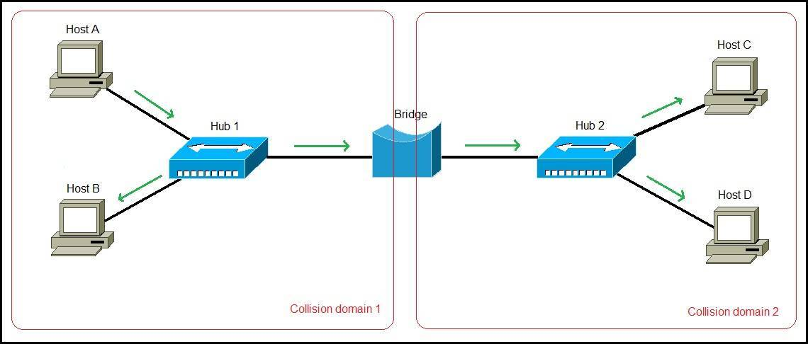
Network with Hub-Bridge

Slide 21
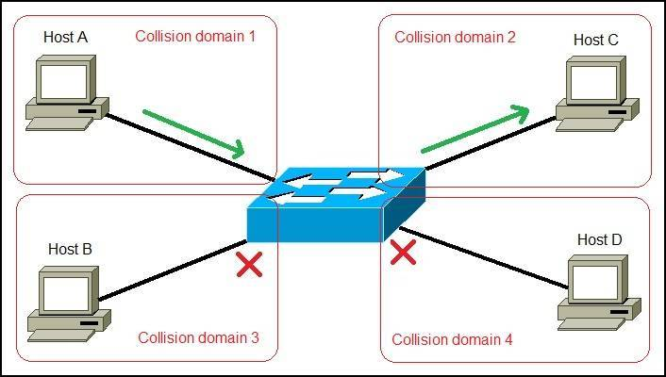
Network with Switch

Slide 22
Learning Bridges
Trivial algorithm
Forward all frames on all (other) LAN’s
Potentially heavy traffic and processing overhead
Optimize by using address information
“Learn” which hosts live on which LAN
Maintain forwarding table
Only forward when necessary (dest. not on same LAN)
Reduces bridge workload

Slide 23
Learning Bridges
Learn table entries based on source address
Timeout entries to allow movement of hosts
Table is an optimization; need not be complete
Always forward broadcast frames
Uses datagram or connectionless forwarding
Host Port
A 1
B 1
C 1
X 2
Y 2
Z 2
A
B
C
Port 1
Bridge
Port 2
X
Y
Z

Slide 24
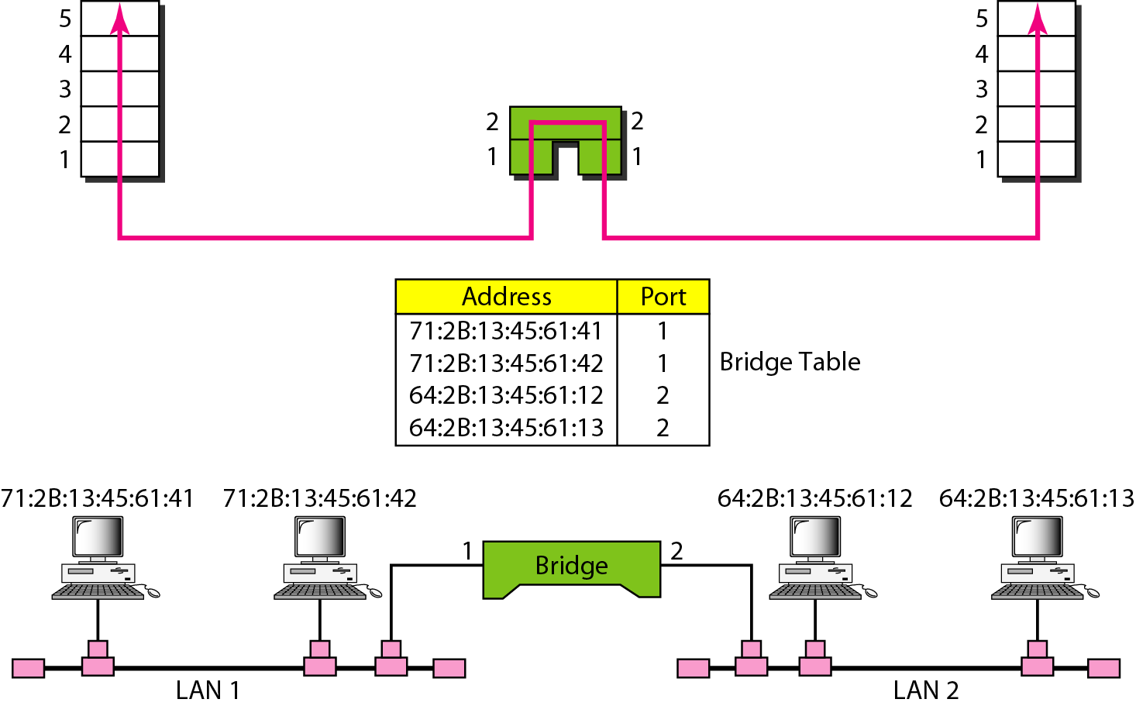
A Bridge Connecting two LANs
A bridge does not change the physical (MAC) addresses in a frame.

Slide 25
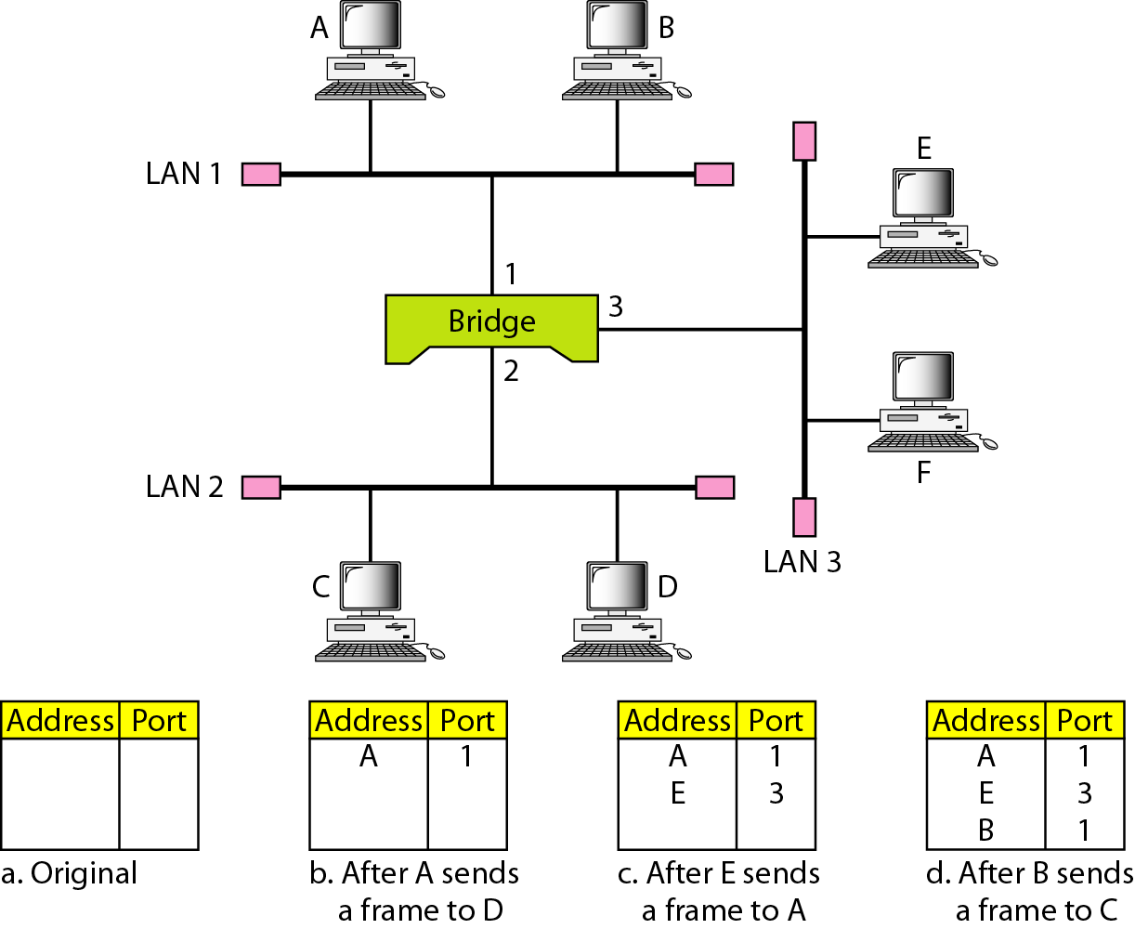
A Learning Bridge and Process of Learning

Slide 26
Learning Bridges
A
B3
B
C
B5
B2
D
B7
K
E
F
B1
G
H
B6
B4
Problem
Redundancy (desirable to handle failures, but …)
Makes extended LAN structure cyclic
Frames may cycle forever (loop problem)
Solution: spanning tree
I
J

Slide 27
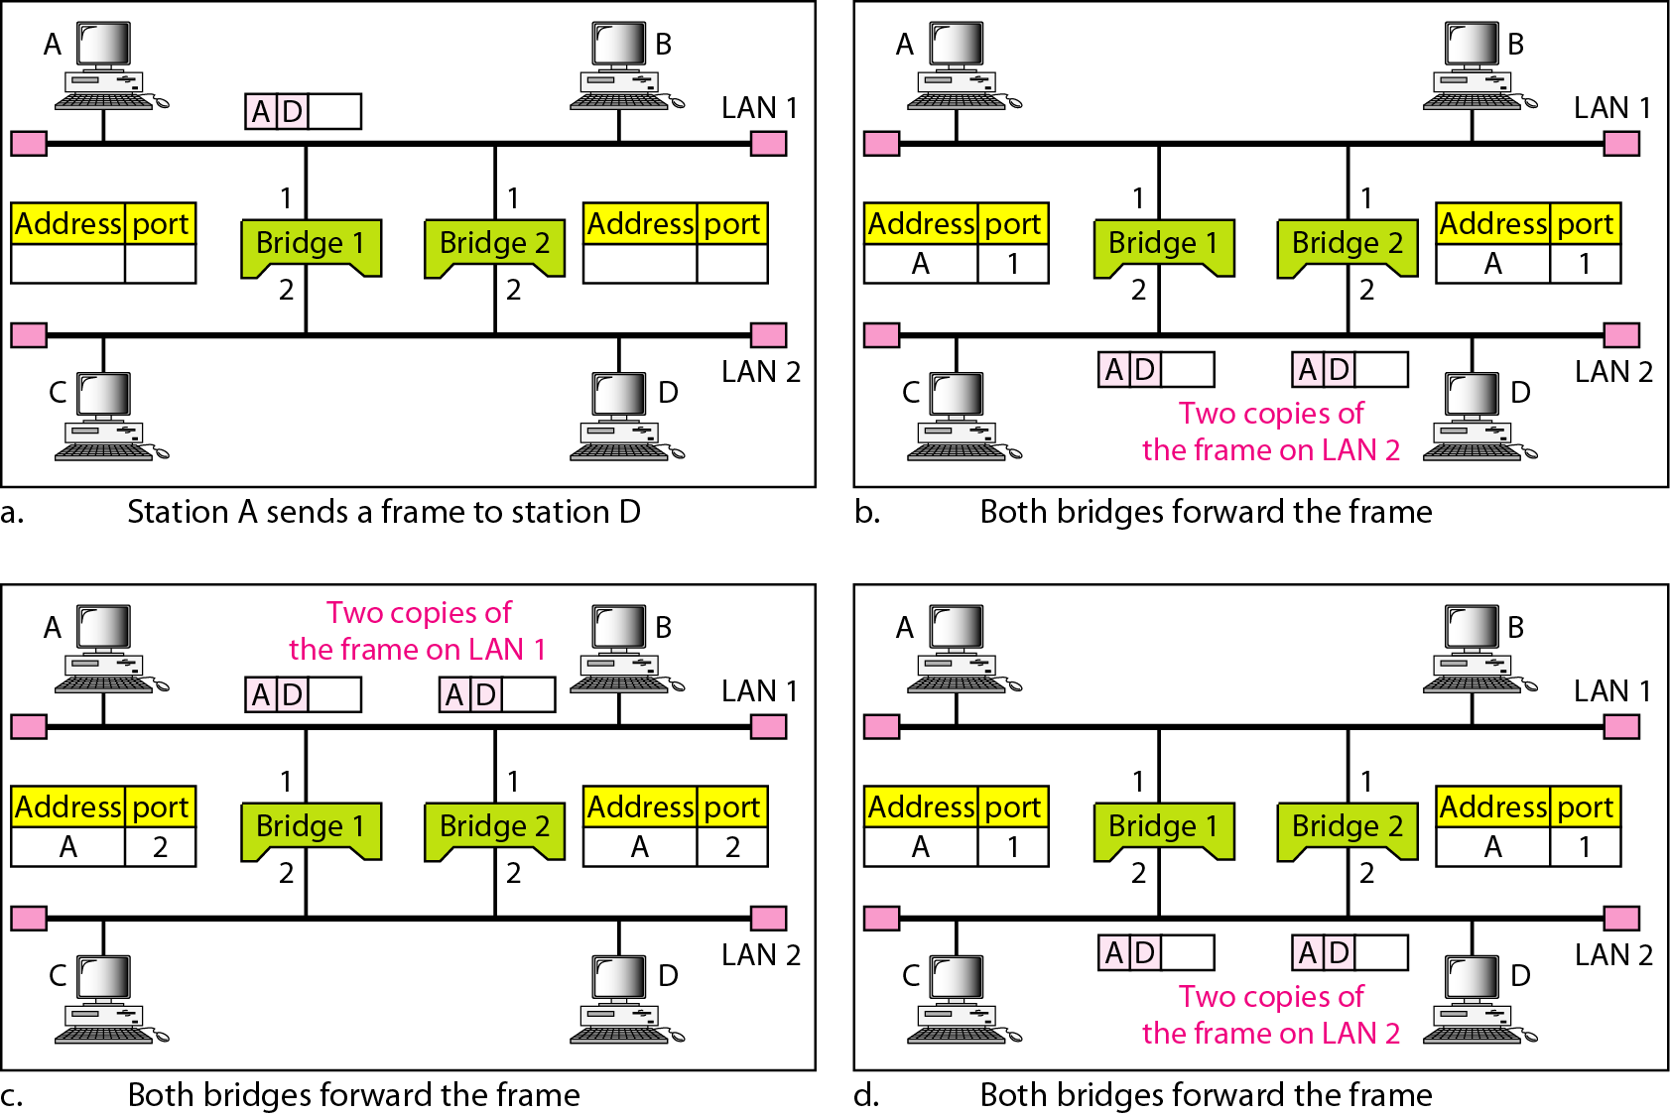
Loop Problem in Learning Bridges
Solution: Spanning Tree

Slide 28
Spanning Tree
Subset of forwarding possibilities
All LAN’s reachable, but
A cyclic Bridges run a distributed algorithm to calculate the spanning tree
Select which bridge actively forward
Developed by Radia Perlman of DEC
Now IEEE 802.1 specification
Reconfigurable algorithm

Slide 29
Spanning Tree Concept
LAN’s and bridges make a bipartite graph
Ports are edges connecting LAN’s to bridges
Spanning tree required
Connect all LAN’s: all vertices of a graph are covered
Can leave out bridges: all edges may not be covered

Slide 30
Spanning Tree Algorithm
Each bridge has a unique, totally-ordered identifier
Select bridge with lowest ID as root bridge
Each bridge determines
Direction of shortest path to root (preferred port)
For each connected LAN, is it the designated bridge?
Select bridge on each LAN closest to root as designated bridge
Use ID (lowest) to break ties)
Ports connecting LAN’s to designated bridges called designated ports

Slide 31
Spanning Tree Algorithm
All designated bridges forward frames
On all designated ports
On preferred port (path leading to root)
A
B3
B
LAN
Designated port
Preferred port
Designated bridge
C
B5
B2
D
B7
K
E
F
B1
B2
G
H
B6
B4
I
J

Slide 32
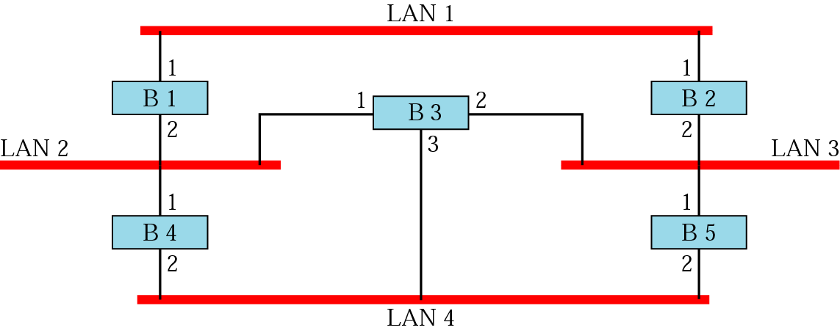
Example: Prior to Spanning Tree Application
What happens if you have a loop of bridges/switches in your LAN?

Slide 33
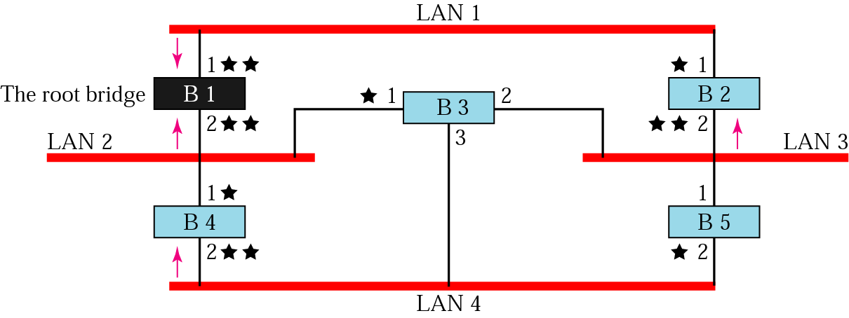
Applying Spanning Tree
Step 1: Select the bridge with smallest ID as root bridge.
Step 2: Mark one port of each bridge (except root bridge) as the root/ proffered port. Root port is the port with least-cost path from the bridge to the root bridge (marked with 1 star).
Step 3: For each LAN, choose a designated bridge. A designated bridge has the least-cost path between the LAN and root bridge (the arrows). Mark the corresponding port that connects the LAN to its designated bridge the designated port (two stars).

Slide 34
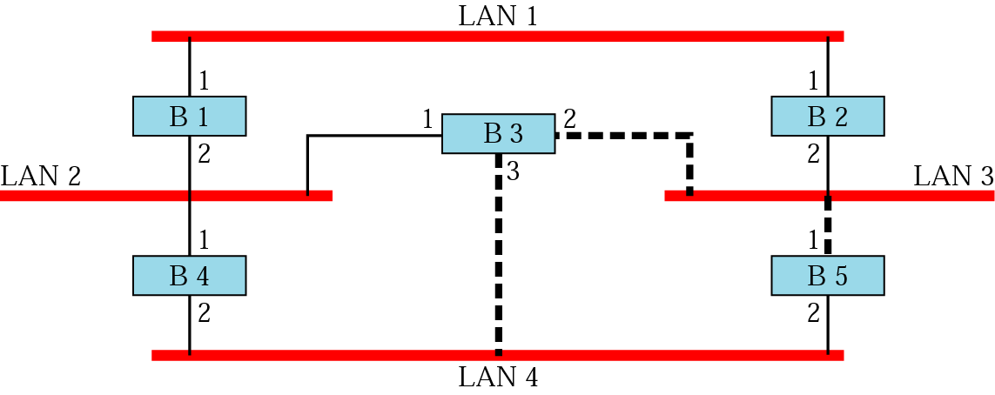
Applying Spanning Tree
Step 4: Mark the root port and designated port as forwarding ports, the others as blocking ports (every port with 1 or 2 stars keep, ports with no stars drop). Note - there is only 1 path between any two bridges.

Slide 35
Distributed Spanning Tree Algorithm
Bridges exchange configuration messages
ID for bridge sending the message
ID for what the sending bridge believes to be root bridge
Distance (hops) from sending bridge to root bridge
Initially, each bridge believes it is the root
Sends a configuration message, and checks if any received message is better than the current best message
Each bridge records current best configuration message for each port

Slide 36
Distributed Spanning Tree Algorithm
Bridges forward configuration messages outward from root bridge i.e., on all designated ports
Bridge assumes it is designated bridge for a LAN until it learns otherwise
A
B3
B
C
B5
B2
D
B7
K
E
F
B1
G
H
B6
B4
I
J

Slide 37
Algorithm Details
In steady state, only root generates configuration messages periodically
Timeout restarts algorithm (claiming “I am root …”)
In steady state, only designated bridges forward configuration messages
Outward from root bridge, to all designated ports
Until they learn they are not designated bridge
Although algorithm is reconfigurable, it is not possible to forward frames over alternative paths

Slide 38
Broadcast and Multicast
Forward all broadcast/multicast frames to all preferred and designated ports
Current practice
Lets hosts decide whether or not to accept frame
Alternative: extend learning to handle groups
Learn when no group members downstream
Group members periodically identify themselves
Accomplished by having each group member sending a frame to the bridge with group address in source field

Slide 39
Uses and Limitations of Bridges
Extend LAN concept
Limited scalability
To O(1,000) hosts
Not to global networks
Not heterogeneous
Some use of address, but
No translation between frame formats

Slide 40
Limitations of Bridges
Do not scale
Spanning tree algorithm does not scale
Broadcast does not scale
Do not accommodate heterogeneity
Only supports networks with same address formats
Caution: beware of transparency
Frame drop because of bridge congestion
Large and variable latency between two hosts
Frames may reorder in extended LANs

Slide 41
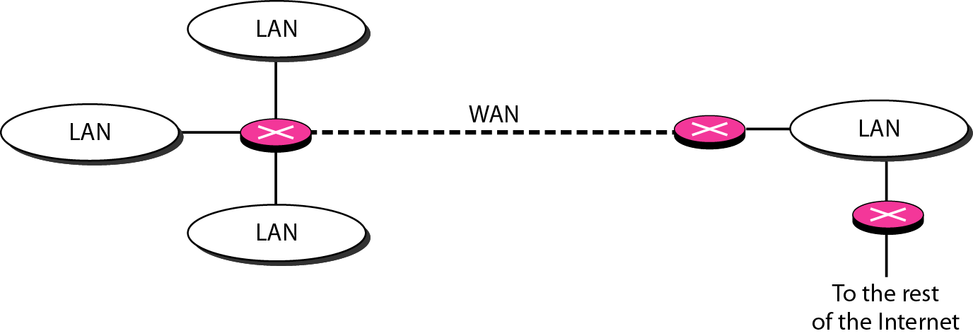
Routers
A network device that forwards packets form one network to another based on their logical or IP addresses (host-to-host addressing).
Based on routing tables, routers read each incoming packet and decide how to forward it.
Routers work at the network layer (layer 3) of the protocol.
A router normally connects LANs and WANs in internet.

Slide 42
Routers
Route traffic from one network to other.
It has routing table that is used for making decisions about route.
A routing tables are normally dynamics and updated using routing protocols.
Routers provides additional features like DHCP server, NAT, Static routing,

Slide 43
Gateway
Device that converts one protocol or format to another
A network gateway converts packets from one protocol to other.
Translate from one protocol to other.
Protocol conversion like VoIP to PSTN or Network Access Control etc.
Does not support dynamic routing

Slide 44
Gateway
A gateway is normally a computer that operates in all five layers of internet or seven layers of OSI model.
A gateway takes an application message, read it, and interprets it.
It can be used as connecting device between two internetworks that uses different models.
A network designed to use the OSI model can be connected to another network using the Internet model.
A gateway connecting two systems can
Take a frame as it arrives from the first system
Move it up to the OSI application layer
And remove message

Slide 45
Implementation and Performance
The cost of processing small packets (parsing headers, deciding output port) dominates other restrictions
Throughput = packets/sec x bits/packet
Moving data from inputs to outputs in parallel may increase the aggregate throughput
Potential bottlenecks
I/O bus bandwidth
Memory bus bandwidth
Processor computing power

